Slide 1

Study Hall Series
April 2024 – Signature Event Orientation

Slide 2
Agenda
Pre-event Features
Terminology
Let’s build a Signature Event!
Resources

Slide 3
Pre-event Features

Slide 4
Pre-Event Features
Intake : solicit and collect event submissions from across campus
PTA : invite people to go on a "planning to attend" list
Bio Update: have your folks update contact info before you start your major comms pushes
Listserv: easier info distribution and collaboration

Slide 5
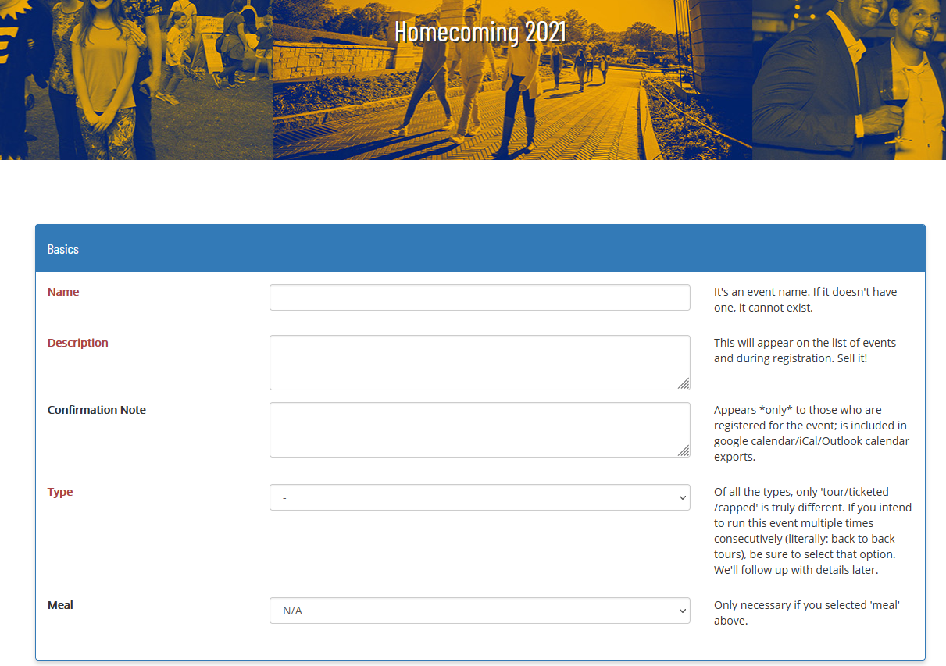
Intake
lightweight (so not every little detail)
passwordless!
easy promotion to a "real" event
Documentation
In use by:
CWRU, Pitt, Emory

Slide 6
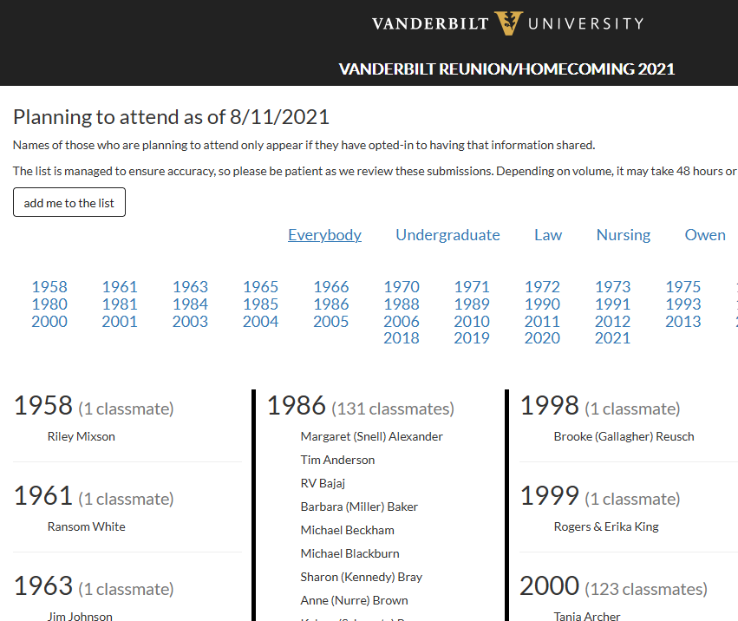
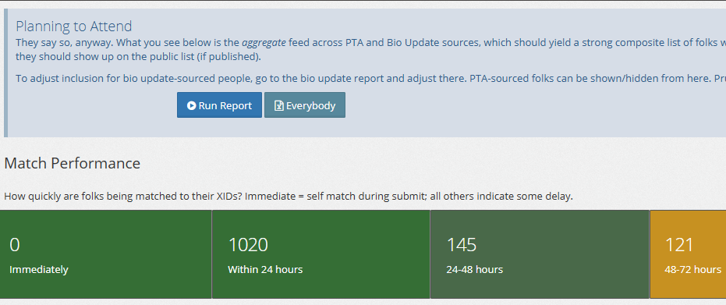
PTA (Planning to Attend
who's likely to register and attend
use with reunion committees
Who’s coming list replaces it when registration begins
Documentation
In use by:
Vanderbilt, Whitman, St. Olaf

Slide 7
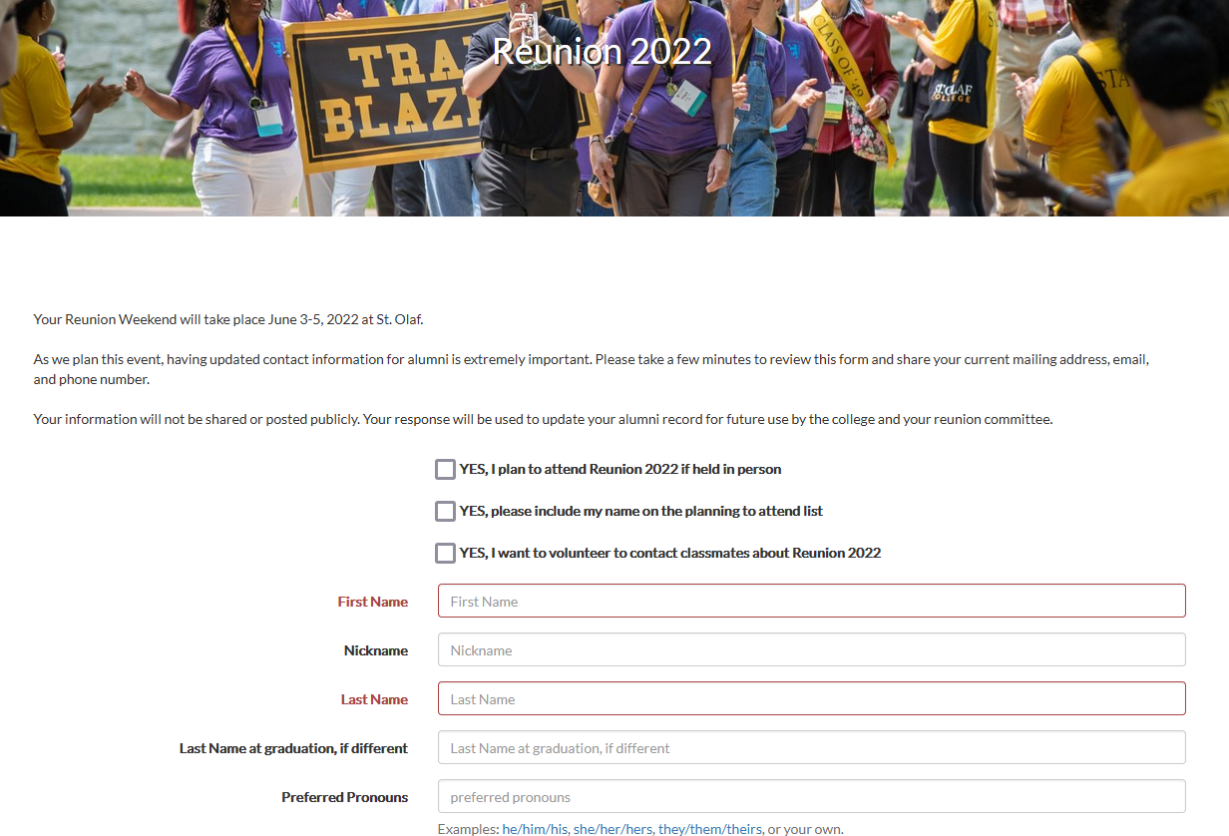
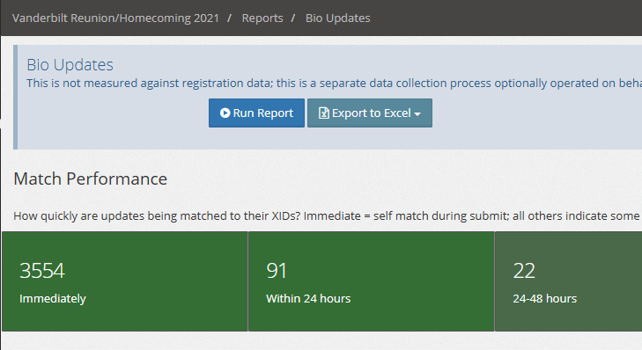
Bio Update
need updated contact information in structured form
can be prefilled!
also integrated with PTA
API-extractable
Documentation
Used by:
Vanderbilt, St. Olaf

Slide 8
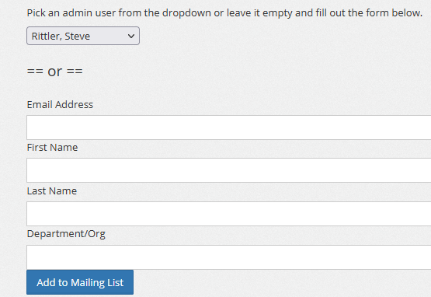
Listserv
Step 1: add people to list
Step 2: send email to list
to: {something}@events.alumniq.com
from: me <steve@alumniq.com>
subject: what's a homecoming?
Step 3: there is no step 3
anyone can be put on it
send email to one address rather than building your own dist list
everyone's in the loop all the time
Used by:
GW, Lehigh, Pitt

Slide 9
Structuring Registration

Slide 10
General Terminology
Master Event – general, overarching settings for entire audience
Org - branding varies, field inclusion at the top level varies
Registration group - clustering pools of registrants with unique housing or language needs
Package - a bundle of paid or included events/products; packages may or may not have a fee
And then of course events and products...
*Package Display Group – if you don’t need a separate registration group but have lots of packages that need to be organized!

Slide 11
Most Clients Have This
Master Event
Org (Homecoming)
All party members share
Reg Group (Homecoming)
Adult All Inclusive Package
Child All Inclusive Package
Adult a la carte Package
Child a la carte Package
Events and products

Slide 12
Multiple Orgs and Registration groups might look like this
Master Event
Org (UG Reunion)
Org (Law Reunion)
All party members share
Reg Group (Class of 1999)
Reg Group (Class of 2000)
Reg Group (Law Reunion)
Adult All Inclusive Package
Pkg Group Law 2000
Pkg Group Law 1999
Adult All Inclusive Package
Adult A la carte Package
Adult A la carte Package
2000 All Inclusive Package
1999 All Inclusive Package
Child All Inclusive Package
Child All Inclusive Package
2000 A la carte Package
1999 A la carte Package
Child A la carte Package
Child A la carte Package
2000 Child Package
1999 Child Package
Events and products

Slide 13
In summary
A master event has one or more orgs
An org has one or more registration groups
A registration group has one or more packages.
A package has events and/or products.
You need the entire structure in place to determine what should be offered to the registrant during the registration process.
Then you can preview what it will look like to the registrant!

Slide 14
Exclusivity
Simplifying Experience
Orgs (constraint on party)
Registration groups (constraint on party)
Package display groups (organize packages)
Package applicability (allows hiding based on adult/child or class year)
Strict Enforcement
If the package or event is truly exclusive, use an ACL.
If the price is truly exclusive, use a fee ACL.
(both require identity to work)

Slide 15
Where do I find that setting?
Org Configuration:
custom short URL
unique landing page content
registration open/close
optional registration fields
self mod controls
Registration group:
reporting segmentation
confirmation email contents
(greatly simplified)
See the What Where docs for more details:
https://help.alumniq.com/signature/whatwhere

Slide 16
Resources
Where to update what: https://help.alumniq.com/signature/whatwhere
Virtual Events: https://help.alumniq.com/signature/virtual
Who’s Coming Lists: https://help.alumniq.com/signature/who
Access Controls: https://help.alumniq.com/signature/acl
Tables and Seating Assignments: https://help.alumniq.com/signature/seating
Housing: https://help.alumniq.com/signature/housing

Slide 17

Thank you!
(bring on the questions!)
christine@alumniq.com

